Slide 1
Colorimetry and its application in image denoising
From Newton to Riemann’s Geometric modeling

Slide 2
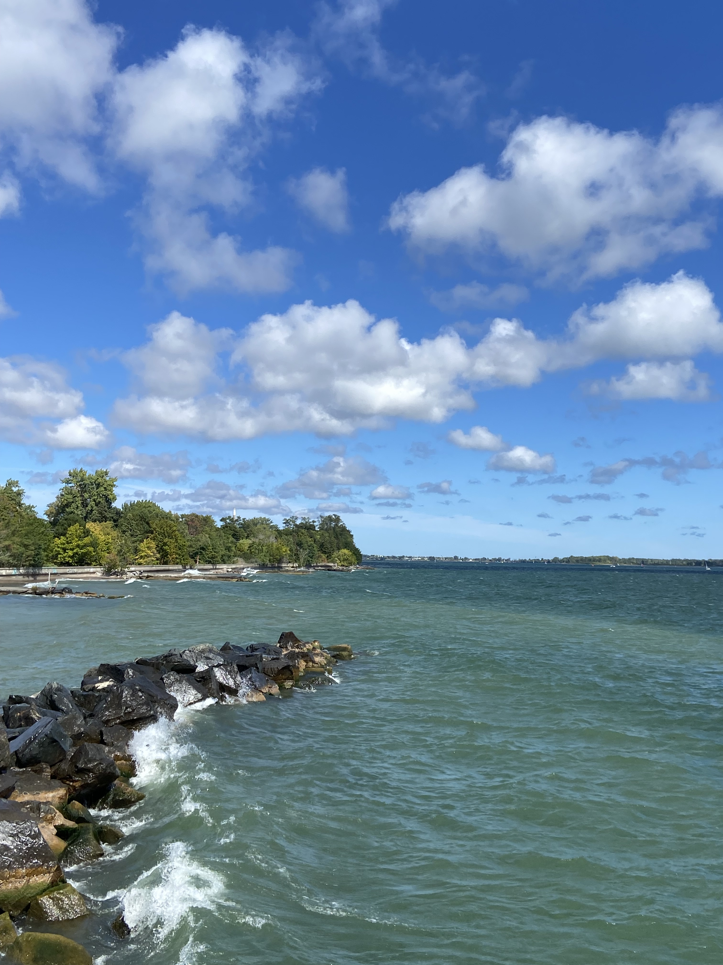
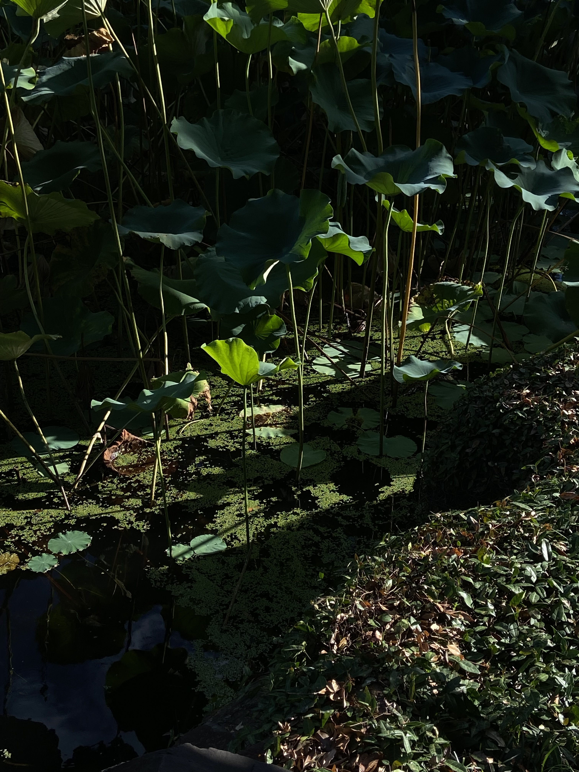
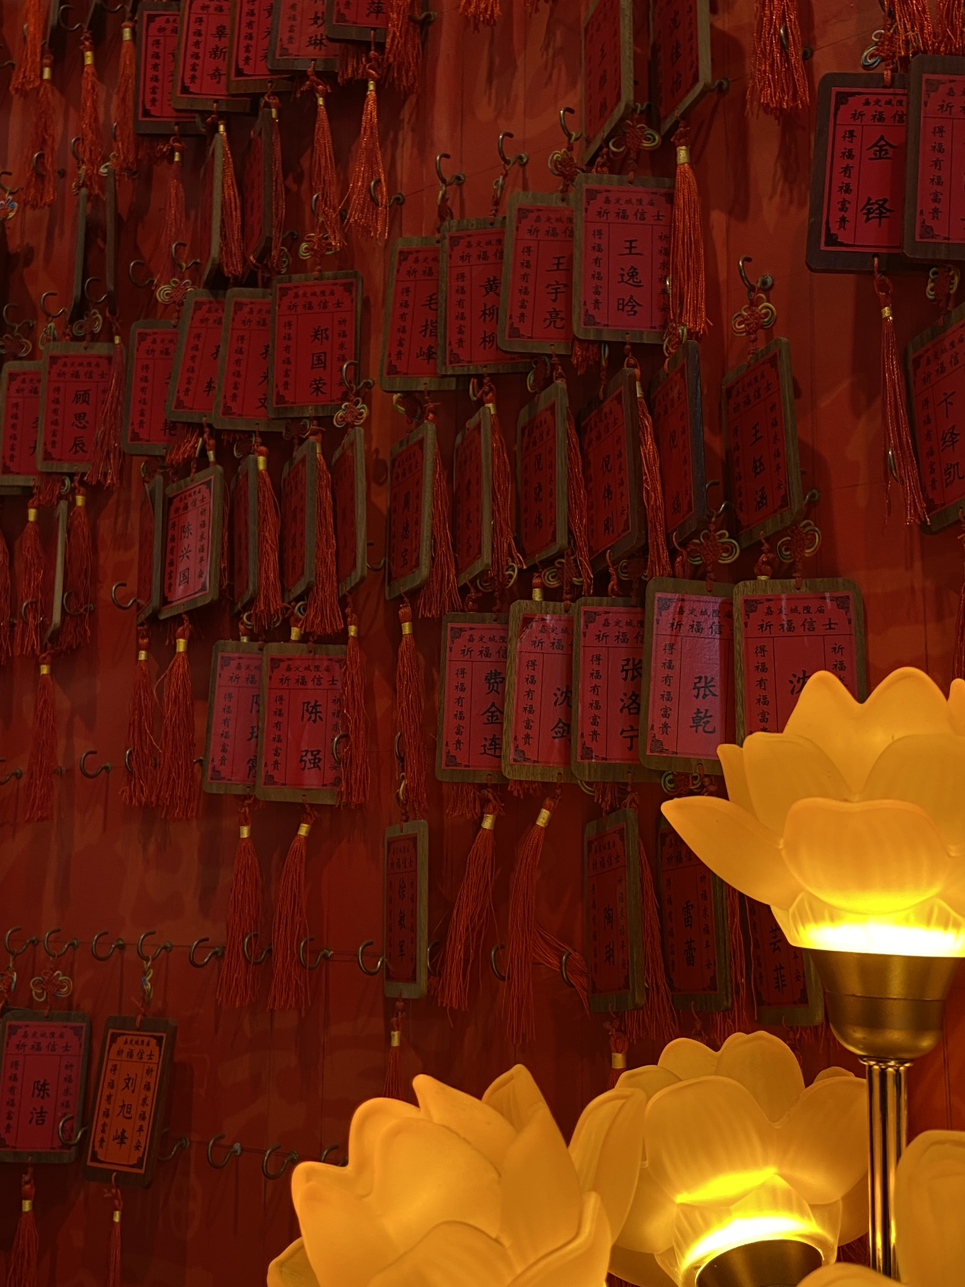

Slide 4
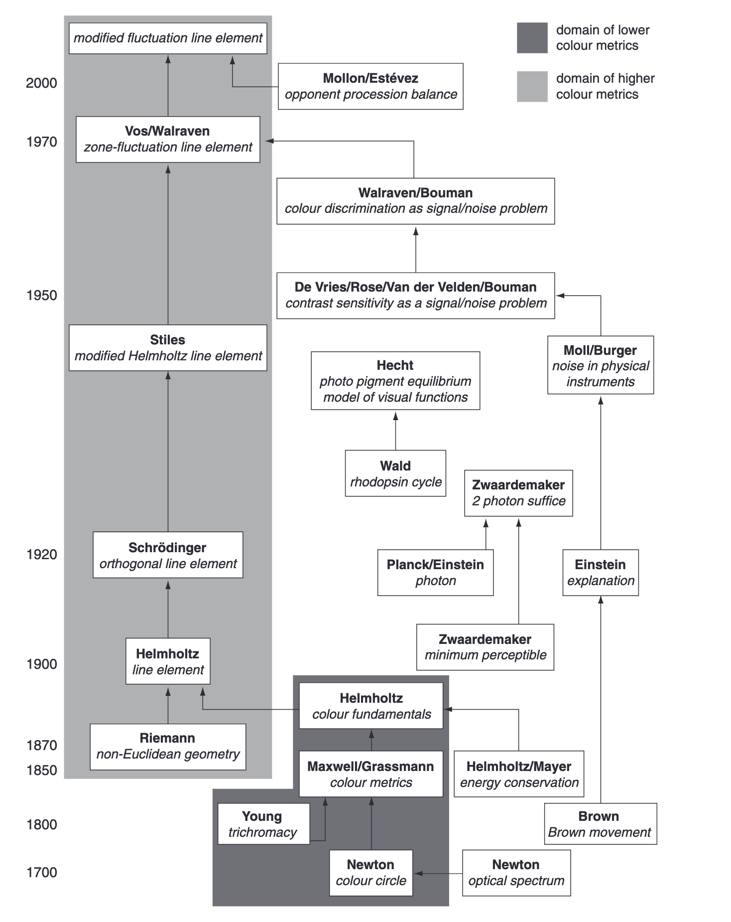

Slide 5
Early Color model: Newton’s Idea

Slide 6
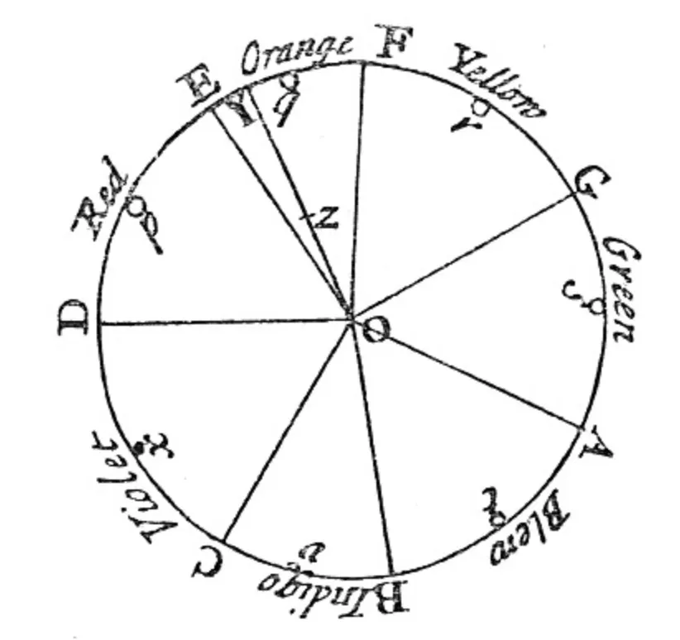
Source: [2]

Slide 7
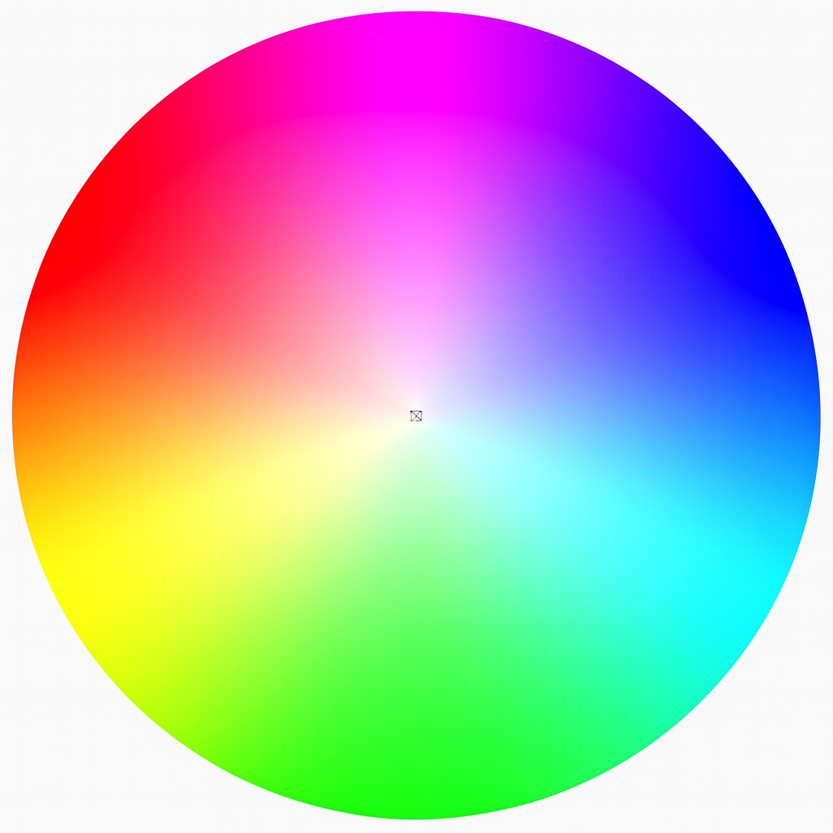
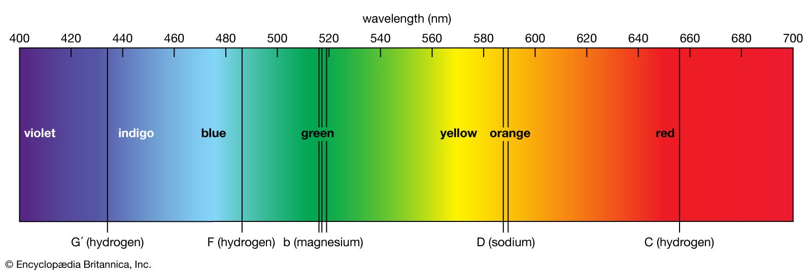
Idea
Principle colors = seven-note muical scale
Color mixing = finding barycenter of “color circles”
Source: [3]

Slide 8
Problem:
Lack of solid physics & biological support
Purple (violet) does not exist in the spectrum
Coarse approximation of color mixing
Coordinate system? Brightness?

Slide 9
Slightly Advance: Helmholtz’s Model

Slide 10
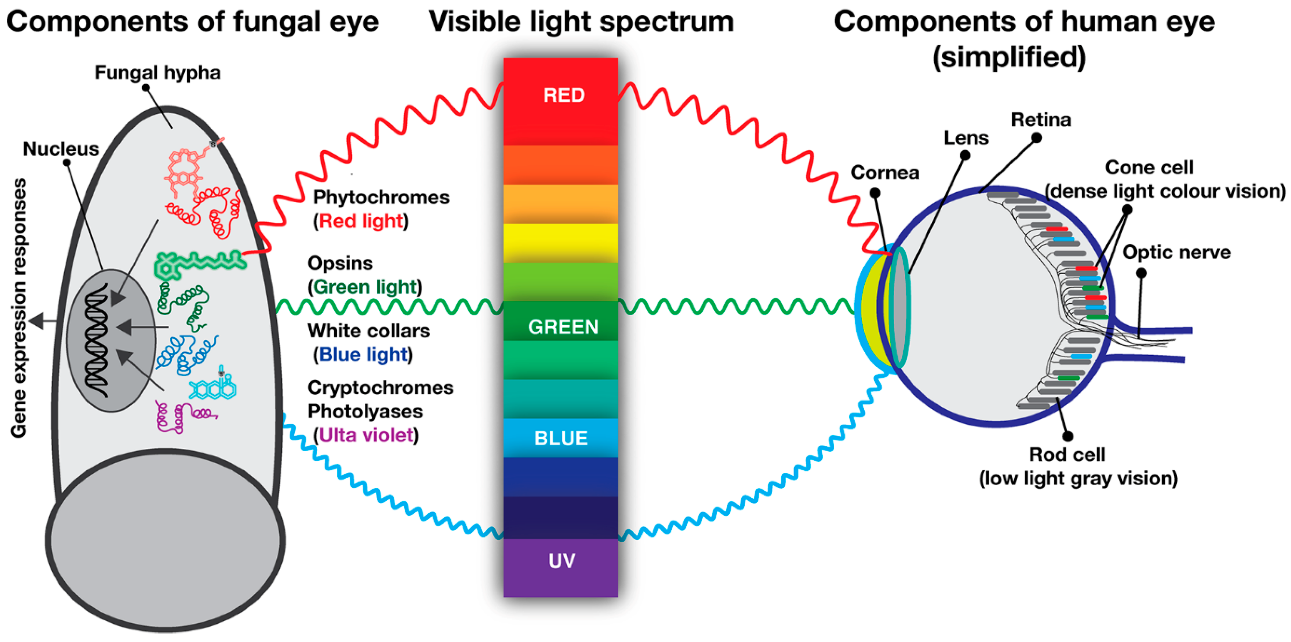
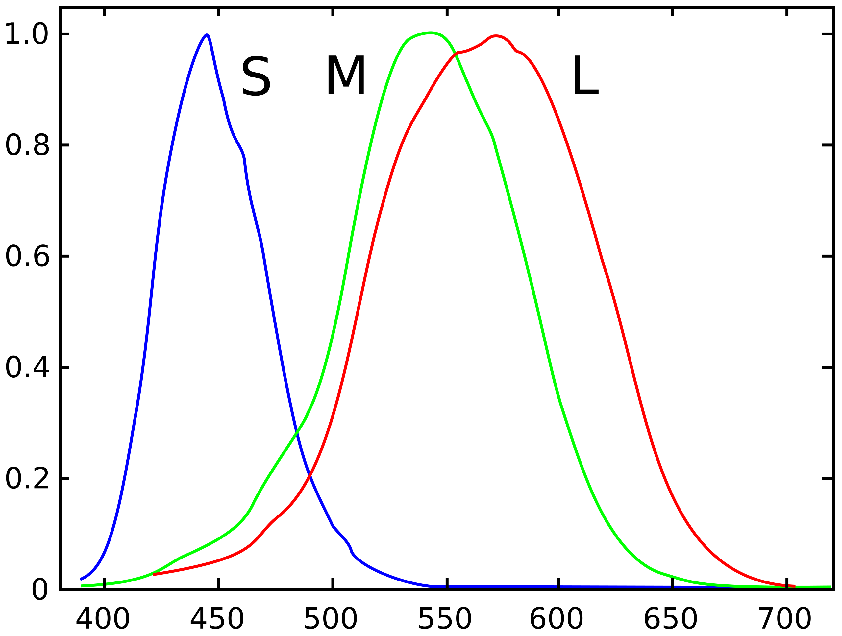
Cone Cells
Source: [4]
Source
Source: [5]

Slide 11
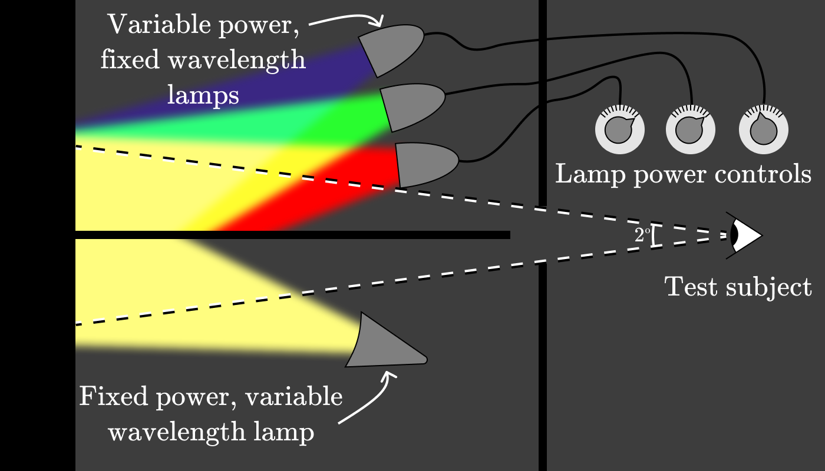

Slide 12
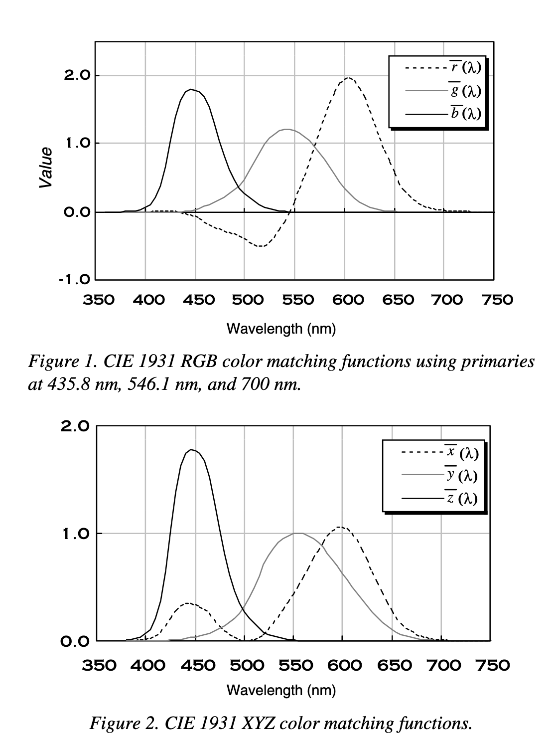
sour

Slide 13
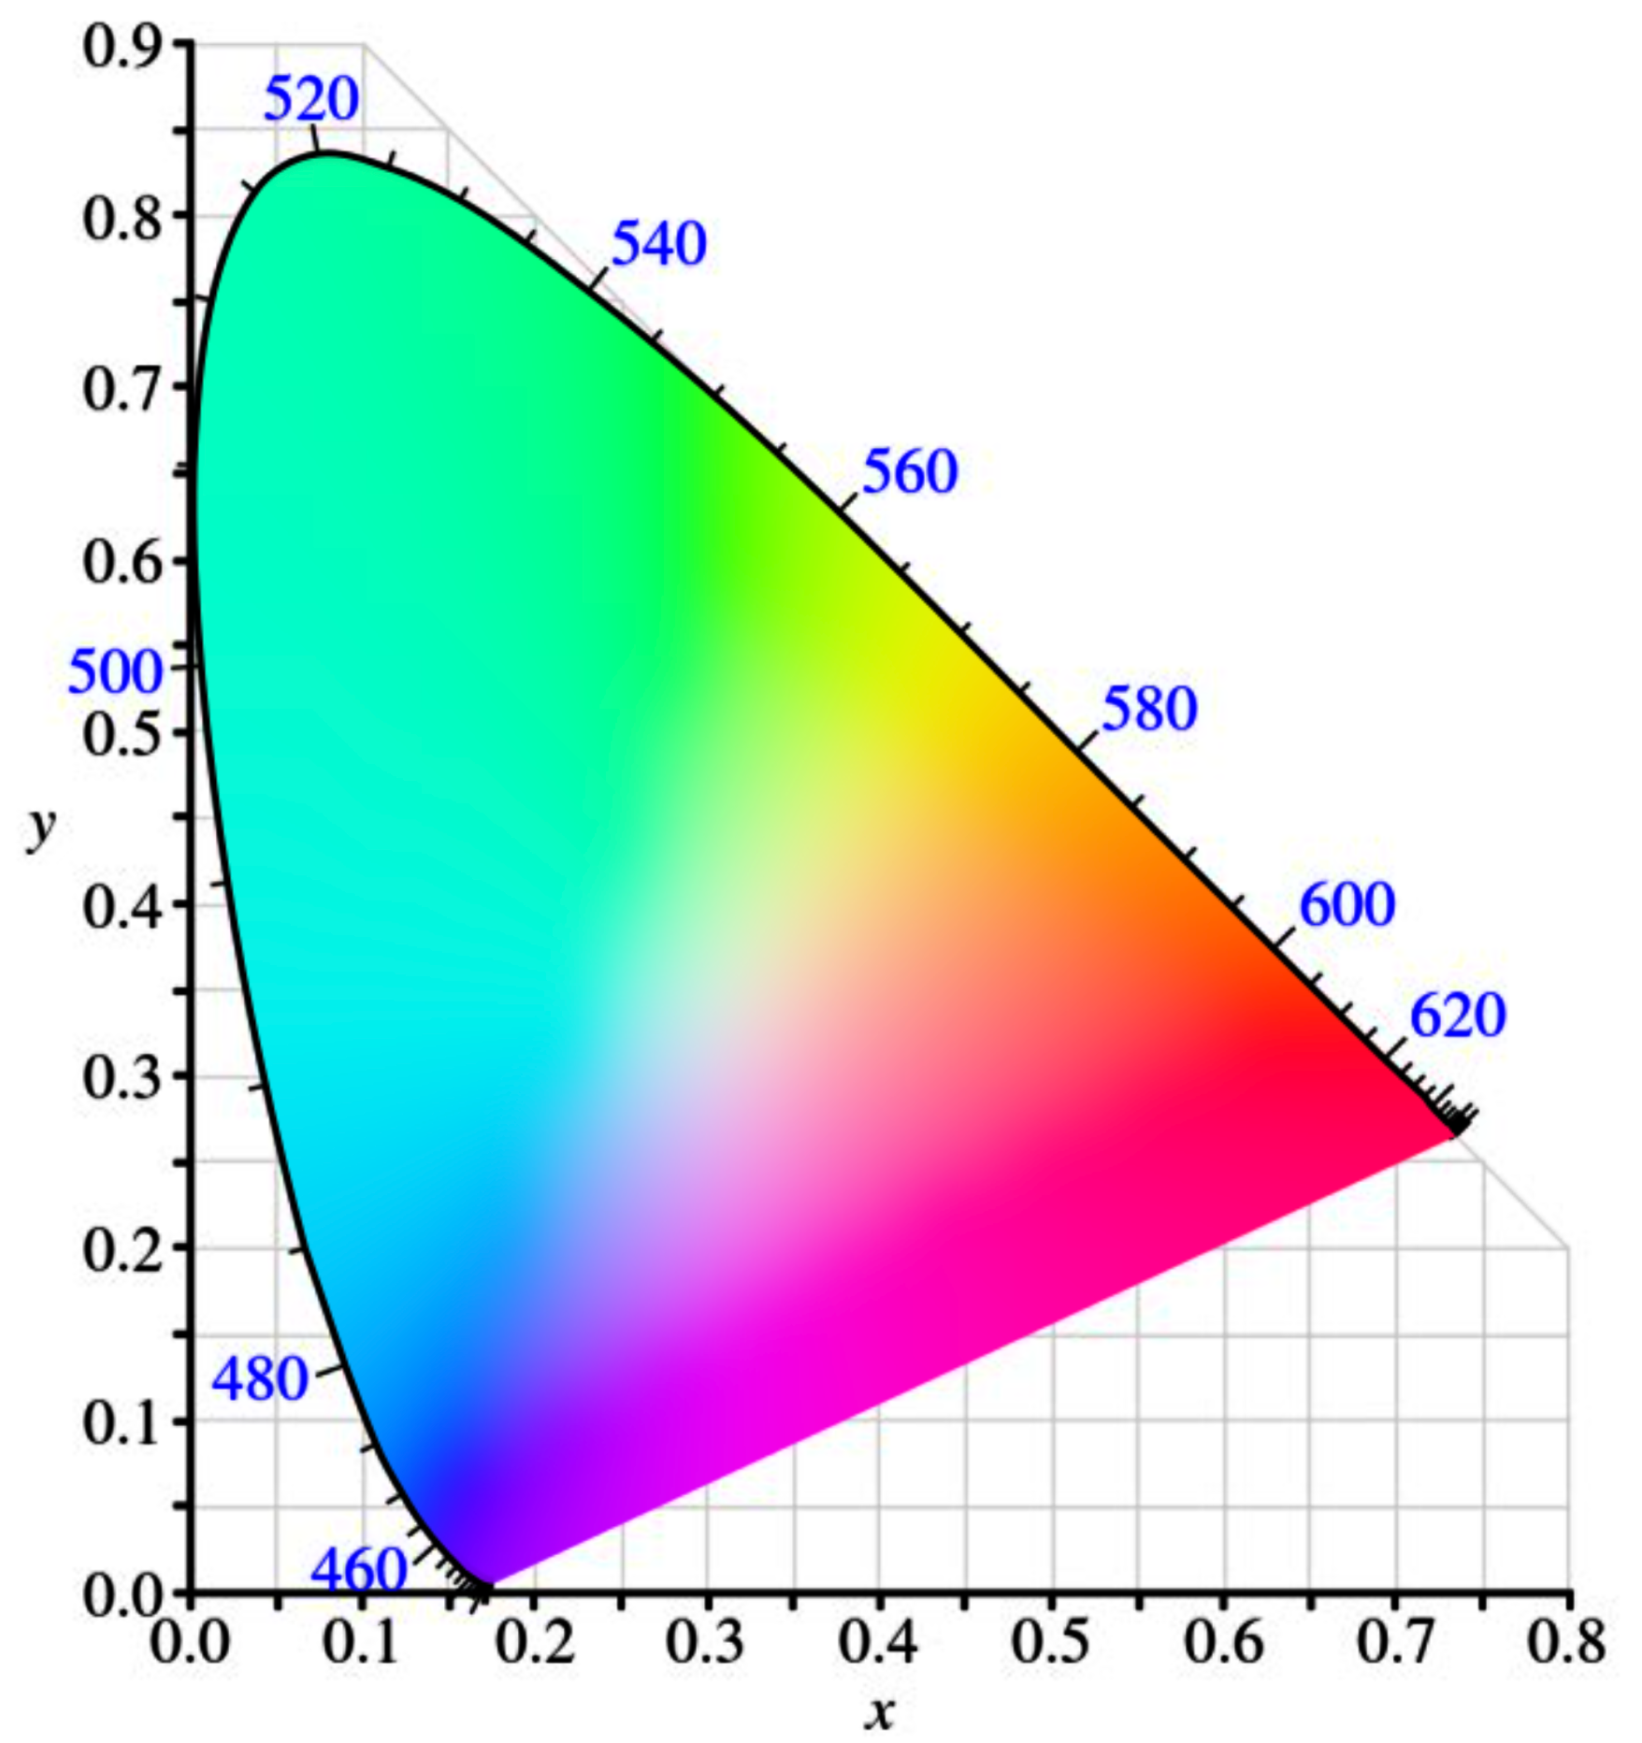
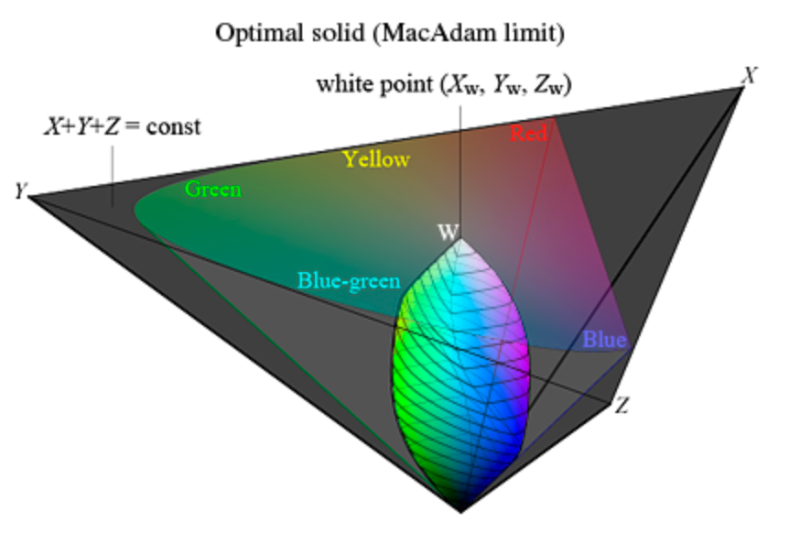

Slide 15
References
Vos JJ. From lower to higher colour metrics: a historical account. Clin Exp Optom. 2006 Nov;89(6):348-60. doi: 10.1111/j.1444-0938.2006.00091.x. PMID: 17026602.
The Project Gutenberg eBook of Opticks:, by Sir Isaac Newton, Knt.
Britannica Editors. "spectrum." Encyclopedia Britannica, February 21, 2025. https://www.britannica.com/science/spectrum.
Bayram, Özlem Sarikaya, and Özgür Bayram. 2023. "An Anatomy of Fungal Eye: Fungal Photoreceptors and Signalling Mechanisms" Journal of Fungi 9, no. 5: 591. https://doi.org/10.3390/jof9050591
Stiles, WS; Burch, JM (1959). "NPL colour-matching investigation: final report". Optica Acta. 6. doi:10.1080/713826267.

